Slide 1
Lecture 04 – Part B Propositional Logic
Dr. Shazzad Hosain
Department of EECS
North South Universtiy
shazzad@northsouth.edu

Slide 2
Knoweldge Representation & Reasoning
Propositional logic is the simplest logic.
Syntax
Semantic
Entailment

Slide 3
Propositional Logic
Syntax

Slide 4
Knoweldge Representation & Reasoning
SYNTAX
It defines the allowable sentences.
Atomic sentences
Logical constants: true, false
Propositional symbols: P, Q, S, ...
Complex sentences
they are constructed from simpler sentences using logical connectives and wrapping parentheses: ( … ).

Slide 5
Knowledge Representation & Reasoning
Logical connectives
¬ (NOT) negation.
∧ (AND) conjunction, operands are conjuncts.
∨ (OR), operands are disjuncts.
⇒ implication (or conditional) A ⇒ B, A is the premise or antecedent and B is the conclusion or consequent. It is also known as rule or if-then statement.
⇔ if and only if (biconditional).

Slide 6
Knoweldge Representation & Reasoning
Logical constants TRUE and FALSE are sentences.
Propositional symbols P1, P2 etc. are sentences.
Symbols P1 and negated symbols ¬ P1 are called literals.
If S is a sentence, ¬ S is a sentence (NOT).
If S1 and S2 is a sentence, S1 ∧ S2 is a sentence (AND).
If S1 and S2 is a sentence, S1 ∨ S2 is a sentence (OR).
If S1 and S2 is a sentence, S1 ⇒ S2 is a sentence (Implies).
If S1 and S2 is a sentence, S1 ⇔ S2 is a sentence (Equivalent).

Slide 7
Knoweldge Representation & Reasoning
Backus-Naur Form
A BNF (Backus-Naur Form) grammar of sentences in propositional Logic is defined by the following rules.
Sentence → AtomicSentence │ComplexSentence
AtomicSentence → True │ False │ Symbol
Symbol → P │ Q │ R …
ComplexSentence → ¬ Sentence
│(Sentence ∧ Sentence)
│(Sentence ∨ Sentence)
│(Sentence ⇒ Sentence)
│(Sentence ⇔ Sentence)

Slide 8
Knoweldge Representation & Reasoning
Order of precedence
From highest to lowest:
parenthesis ( Sentence )
NOT ¬
AND ∧
OR ∨
Implies ⇒
Equivalent ⇔
Special cases: A ∨ B ∨ C no parentheses are needed
What about A ⇒ B ⇒ C???

Slide 9
Knoweldge Representation & Reasoning
P means “It is hot.”
Q means “It is humid.”
R means “It is raining.”
(P ∧ Q) → R
“If it is hot and humid, then it is raining”
Q → P
“If it is humid, then it is hot”
A better way:
Hot = “It is hot”
Humid = “It is humid”
Raining = “It is raining”

Slide 10
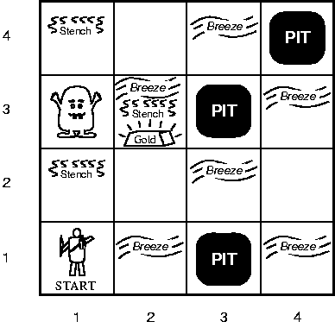
Knoweldge Representation & Reasoning
P_{x,y} is true if there is a pit in [x,y]
W_{x,y} is true if there is a wumpus
in [x,y], dead or alive
B_{x,y} if agent perceives breeze in [x,y]
S_{x,y} if agent perceives stench in [x,y]
Our goal is to derive ¬ P_{1,2}
R₁ : ¬ P_{1,1}
R₂ : B_{1,1} ⬄ (P_{1,2} ∨ P_{2,1})
R₃ : B_{2,1} ⬄ (P_{1,1} ∨ P_{2,2} ∨ P_{3,1})
True in all wumpus worlds
R₄ : ¬ B_{1,1}
R₅ : B_{2,1}

Slide 11
Propositional Logic
Semantic

Slide 12
Knoweldge Representation & Reasoning
SEMANTIC
SEMANTIC: It defines the rules for determining the truth of a sentence with respect to a particular model.
The question:
How to compute the truth value of any sentence given a model?

Slide 13
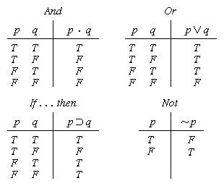
Truth tables

Slide 14


Truth tables
The five logical connectives:
A complex sentence:

Slide 15
Propositional Logic
Entailment

Slide 16
Knoweldge Representation & Reasoning
Propositional Inference:
Enumeration Method
(Model checking)
Let α=Α ∨ Β and
KB =(Α ∨ C) ∧(B ∨ ¬C)
Is it the case that KB ╞ α ?
Check all possible models -- α must be true whenever KB is true.
A | B | C | KB (Α ∨ C) ∧ (B ∨ ¬C) | α Α ∨ Β
False | False | False | False | False
False | False | True | False | False
False | True | False | False | True
False | True | True | True | True
True | False | False | True | True
True | False | True | False | True
True | True | False | True | True
True | True | True | True | True

Slide 17
Knoweldge Representation & Reasoning
A | B | C | KB (Α ∨ C) ∧ (B ∨ ¬C) | α Α ∨ Β
False | False | False | False | False
False | False | True | False | False
False | True | False | False | True
False | True | True | True | True
True | False | False | True | True
True | False | True | False | True
True | True | False | True | True
True | True | True | True | True
KB ╞ α

Slide 18
Knoweldge Representation & Reasoning
Proof methods
Model checking
Truth table enumeration (sound and complete for propositional logic).
For n symbols, the time complexity is O(2^{n}).
►Need a smarter way to do inference
Application of inference rules
Legitimate (sound) generation of new sentences from old.
Proof = a sequence of inference rule applications.
Can use inference rules as operators in a standard search algorithm.

Slide 19
Knoweldge Representation & Reasoning
Validity and Satisfiability
A sentence is valid (a tautology) if it is true in all models
e.g., True, A ∨ ¬A, A ⇒ A, (A ∧ (A ⇒ B)) ⇒ B
Validity is connected to inference via the Deduction Theorem:
KB ╞ α if and only if (KB ∧ α) is valid
A sentence is satisfiable if it is true in some model
e.g., A ∨ B
A sentence is unsatisfiable if it is false in all models
e.g., A ∧ ¬A
Satisfiability is connected to inference via the following:
KB ╞ α if and only if (KB ∧ ¬α) is unsatisfiable
(there is no model for which KB=true and α is false)

Slide 20
Knoweldge Representation & Reasoning
Propositional Logic: Inference rules
An inference rule is sound if the conclusion is true in all cases where the premises are true.
α Premise
_____
β Conclusion

Slide 21
Knoweldge Representation & Reasoning
Propositional Logic: An inference rule: Modus Ponens
From an implication and the premise of the implication, you can infer the conclusion.
α ⇒ β, α Premise
___________
β Conclusion
Example:
“raining implies soggy courts”, “raining”
Infer: “soggy courts”

Slide 22
Knoweldge Representation & Reasoning
Propositional Logic: An inference rule: Modus Tollens
From an implication and the premise of the implication, you can infer the conclusion.
α ⇒ β, ¬ β Premise
___________
¬ α Conclusion
Example:
“raining implies soggy courts”, “courts not soggy”
Infer: “not raining”

Slide 23
Knoweldge Representation & Reasoning
Propositional Logic: An inference rule: AND elimination
From a conjunction, you can infer any of the conjuncts.
α₁∧ α₂∧ … ∧ α_{n} Premise
_______________
α_{i} Conclusion
Question: show that Modus Ponens and And Elimination are sound?

Slide 24
Knoweldge Representation & Reasoning
Propositional Logic: other inference rules
And-Introduction
α₁, α₂, …, α_{n} Premise
_______________
α₁∧ α₂∧ … ∧ α_{n} Conclusion
Double Negation
¬¬α Premise
_______
α Conclusion
Rules of equivalence can be used as inference rules. (Tutorial).

Slide 25
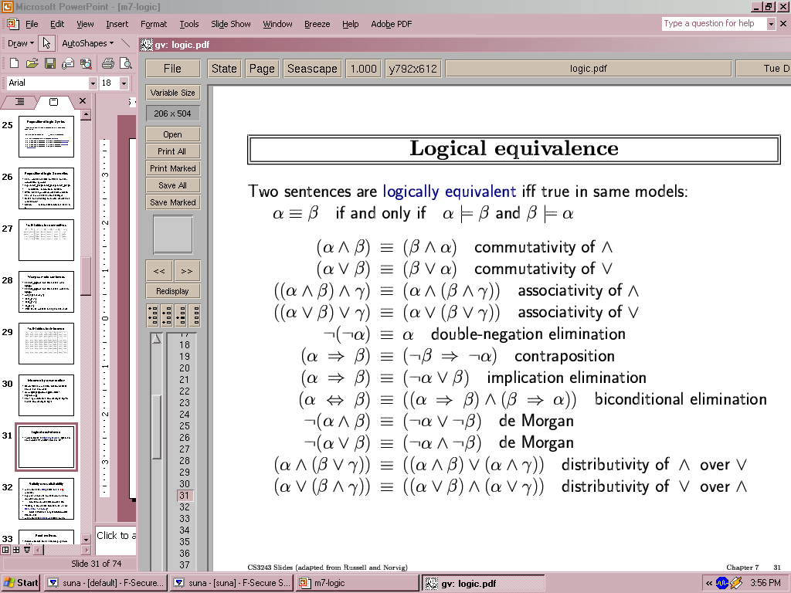
Knoweldge Representation & Reasoning
Propositional Logic: Equivalence rules
Two sentences are logically equivalent iff they are true in the same models: α ≡ ß iff α╞ β and β╞ α.

Slide 26
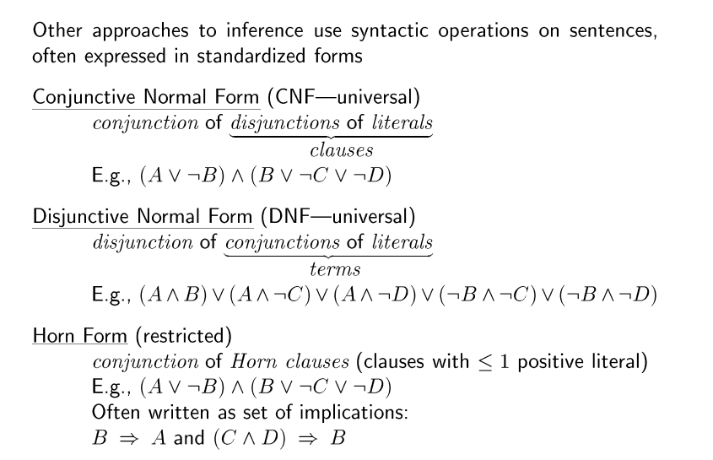
Knoweldge Representation & Reasoning

Slide 27
Inference and proofs
P_{x,y} is true if there is a pit in [x,y]
W_{x,y} is true if there is a wumpus
in [x,y], dead or alive
B_{x,y} if agent perceives breeze in [x,y]
S_{x,y} if agent perceives stench in [x,y]
Our goal is to derive ¬ P_{1,2}
R₁ : ¬ P_{1,1}
R₂ : B_{1,1} ⇔ (P_{1,2} ∨ P_{2,1})
R₃ : B_{2,1} ⇔ (P_{1,1} ∨ P_{2,2} ∨ P_{3,1})
True in all wumpus worlds
R₄ : ¬ B_{1,1}
R₅ : B_{2,1}

Slide 28
Inference and proofs
Our goal is to derive ¬ P_{1,2}
R₁ : ¬ P_{1,1}
R₂ : B_{1,1} ⇔ (P_{1,2} ∨ P_{2,1})
R₃ : B_{2,1} ⇔ (P_{1,1} ∨ P_{2,2} ∨ P_{3,1})
True in all wumpus worlds
R₄ : ¬ B_{1,1}
R₅ : B_{2,1}
Apply biconditional elimination to R₂
R₆ : (B_{1,1} ⇒ (P_{1,2} ∨ P_{2,1})) ∧ ((P_{1,2} ∨ P_{2,1}) ⇒ B_{1,1} )

Slide 29

Inference and proofs
Apply and elimination to R₆
Our goal is to derive ¬ P_{1,2}
R₁ : ¬ P_{1,1}
R₂ : B_{1,1} ⇔ (P_{1,2} ∨ P_{2,1})
R₃ : B_{2,1} ⇔ (P_{1,1} ∨ P_{2,2} ∨ P_{3,1})
R₇ : ((P_{1,2} ∨ P_{2,1}) ⇒ B_{1,1} )
Apply contraposition to R₇
True in all wumpus worlds
R₄ : ¬ B_{1,1}
R₅ : B_{2,1}
R₈ : (¬B_{1,1} ⇒ ¬ (P_{1,2} ∨ P_{2,1}) )
Apply Modus Ponens and
the percept ¬B_{1,1}
R₈ : ¬ (P_{1,2} ∨ P_{2,1})
Apply biconditional elimination to R₂
R₉ : ¬ P_{1,2} ∧ ¬ P_{2,1}
We can apply any search algorithms
R₆ : (B_{1,1} ⇒ (P_{1,2} ∨ P_{2,1})) ∧ ((P_{1,2} ∨ P_{2,1}) ⇒ B_{1,1} )

Slide 30
Completeness of Inference Algorithms
Search algorithms such as IDS are complete
But if the set of rules are inadequate, for example
If we remove the biconditional rule
The proof would not go through

Slide 31
Knoweldge Representation & Reasoning
Resolution
Unit Resolution inference rule:
l₁ ∨ … ∨ l_{i} ∨ … ∨ l_{k} , m
l₁ ∨ … ∨ l_{i-1} ∨ l_{i+1} ∨ … ∨ l_{k}
where l_{i} and m are complementary literals: m = ¬l_{i}

Slide 32
Knoweldge Representation & Reasoning
Resolution
Unit Resolution inference rule:
P_{1,1} ∨ P_{2,2} ∨ P_{3,1}, ¬ P_{2,2}
P_{1,1} ∨ P_{3,1}
If there’s a pit in one of [1,1], [2,2] and [3,1], and it’s not in [2,2], then it’s in [1,1] or [3,1]

Slide 33
Knoweldge Representation & Reasoning
Resolution
Full resolution inference rule:
l₁ ∨ … ∨ l_{k} , m₁ ∨ … ∨ m_{n}
l₁∨ … ∨l_{i-1}∨l_{i+1} ∨…∨l_{k}∨m₁∨…∨m_{j-1}∨m_{j+1}∨...∨ m_{n}
where l_{i} and m_{j} are complementary literals.

Slide 34
Knoweldge Representation & Reasoning
Resolution
For simplicity let’s consider clauses of length two:
l₁ ∨ l₂, ¬l₂ ∨ l₃
l₁ ∨ l₃
To derive the soundness of resolution consider the values l₂ can take:
• If l₂ is True, then since we know that ¬l₂ ∨ l₃ holds, it
must be the case that l3 is True.
• If l₂ is False, then since we know that l₁ ∨ l₂ holds, it
must be the case that l₁ is True.

Slide 35
Knoweldge Representation & Reasoning
factoring
Remove multiple copies of literals
A ∨ B, ¬ B ∨ A
A

Slide 36
Knoweldge Representation & Reasoning
Resolution
1. Properties of the resolution rule:
• Sound
• Complete (yields to a complete inference algorithm).
2. The resolution rule forms the basis for a family of complete inference algorithms.
3. Resolution rule is used to either confirm or refute a sentence but it cannot be used to enumerate true sentences.

Slide 37
Knoweldge Representation & Reasoning
Resolution
4. Resolution can be applied only to disjunctions of literals. How can it lead to a complete inference procedure for all propositional logic?
5. Any knowledge base can be expressed as a conjunction of disjunctions (conjunctive normal form, CNF).
E.g., (A ∨ ¬B) ∧ (B ∨ ¬C ∨ ¬D)

Slide 38
Knoweldge Representation & Reasoning
Resolution: Inference procedure:
Example of proof by contradiction
KB = (B_{1,1} ⇔ (P_{1,2} ∨ P_{2,1})) ∧ ¬ B_{1,1}
α = ¬P_{1,2}
convert (KB ∧ ¬α) to CNF and apply IP

Slide 39
Example: Conversion to CNF
B_{1,1} ⇔ (P_{1,2} ∨ P_{2,1})
Eliminate ⇔, replacing α ⇔ β with (α ⇒ β)∧(β ⇒ α).
(B_{1,1} ⇒ (P_{1,2} ∨ P_{2,1})) ∧ ((P_{1,2} ∨ P_{2,1}) ⇒ B_{1,1})
2. Eliminate ⇒, replacing α ⇒ β with ¬α∨ β.
(¬B_{1,1} ∨ P_{1,2} ∨ P_{2,1}) ∧ (¬(P_{1,2} ∨ P_{2,1}) ∨ B_{1,1})
3. Move ¬ inwards using de Morgan's rules and double-negation:
(¬B_{1,1} ∨ P_{1,2} ∨ P_{2,1}) ∧ ((¬P_{1,2} ∧ ¬P_{2,1}) ∨ B_{1,1})
4. Apply distributive law (∧ over ∨) and flatten:
(¬B_{1,1} ∨ P_{1,2} ∨ P_{2,1}) ∧ (¬P_{1,2} ∨ B_{1,1}) ∧ (¬P_{2,1} ∨ B_{1,1})

Slide 40
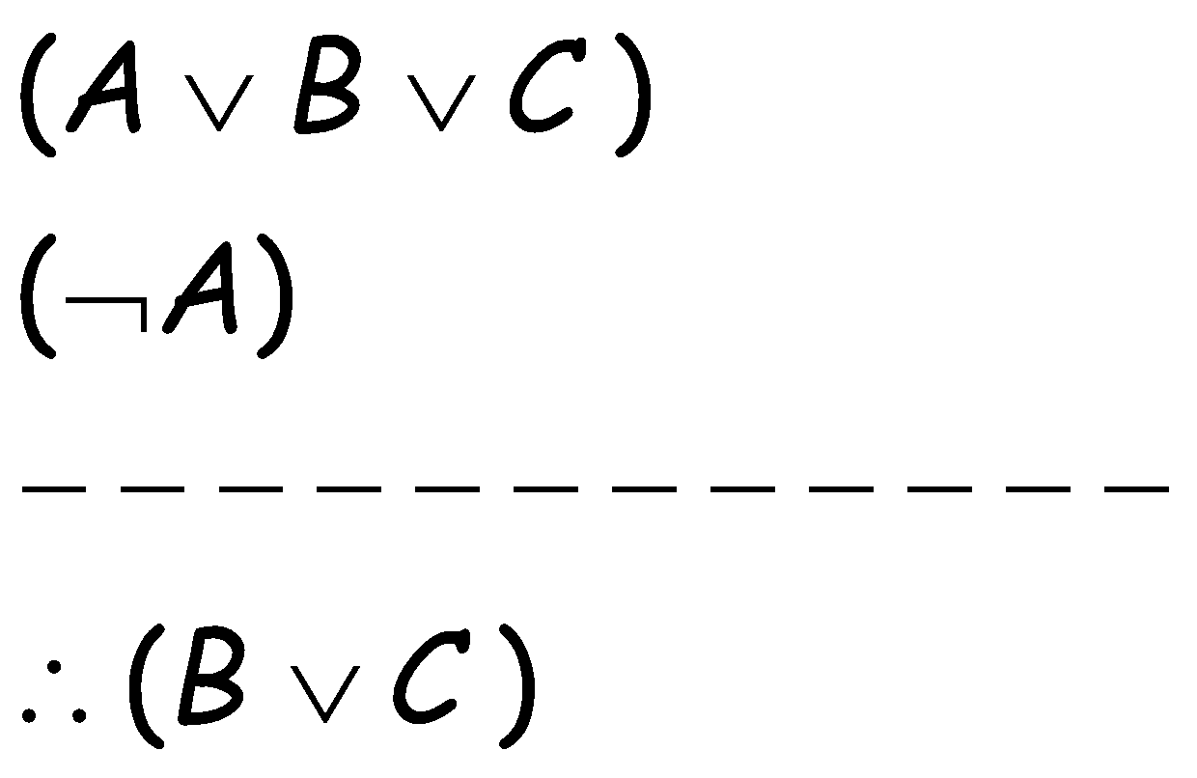
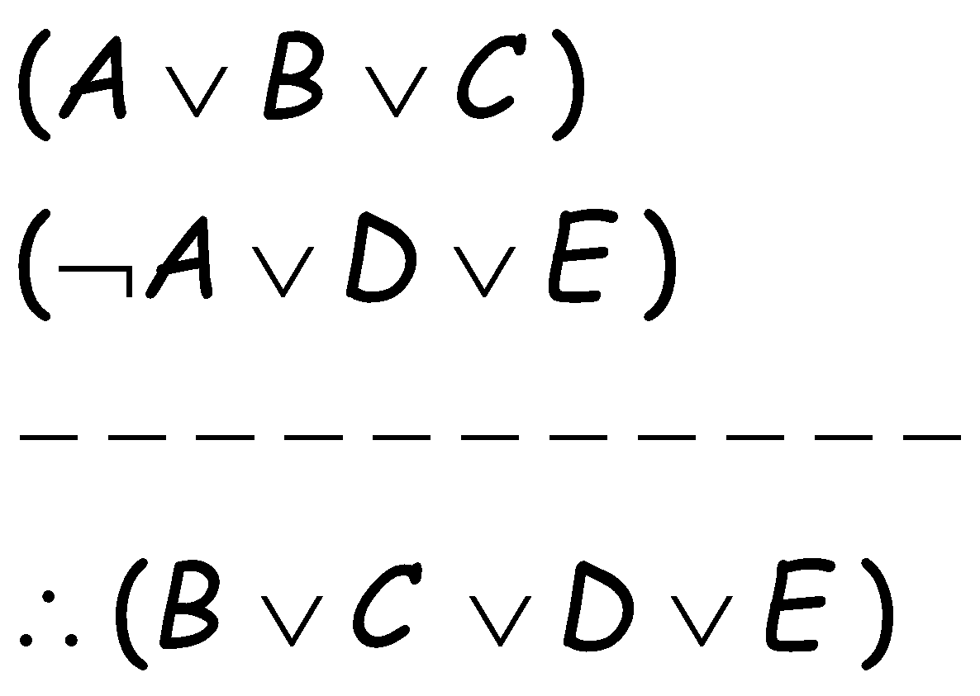
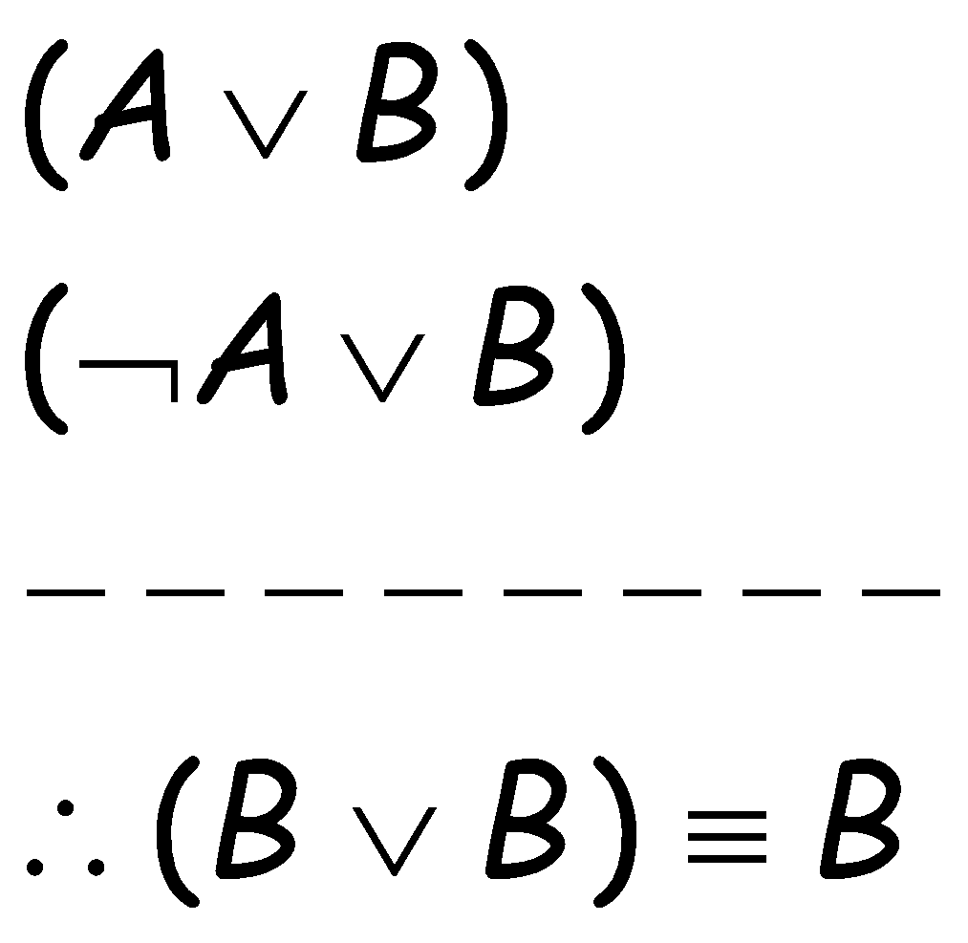
Resolution
Resolution: inference rule for CNF: sound and complete!
“If A or B or C is true, but not A, then B or C must be true.”
“If A is false then B or C must be true, or if A is true
then D or E must be true, hence since A is either true or
false, B or C or D or E must be true.”
Simplification

Slide 41
Knoweldge Representation & Reasoning
Resolution: Inference procedure
6. Inference procedures based on resolution work by using the principle of proof by contradiction:
To show that KB ╞ α we show that (KB ∧ ¬α) is unsatisfiable
The process: 1. convert KB ∧ ¬α to CNF
2. resolution rule is applied to the resulting clauses.

Slide 42
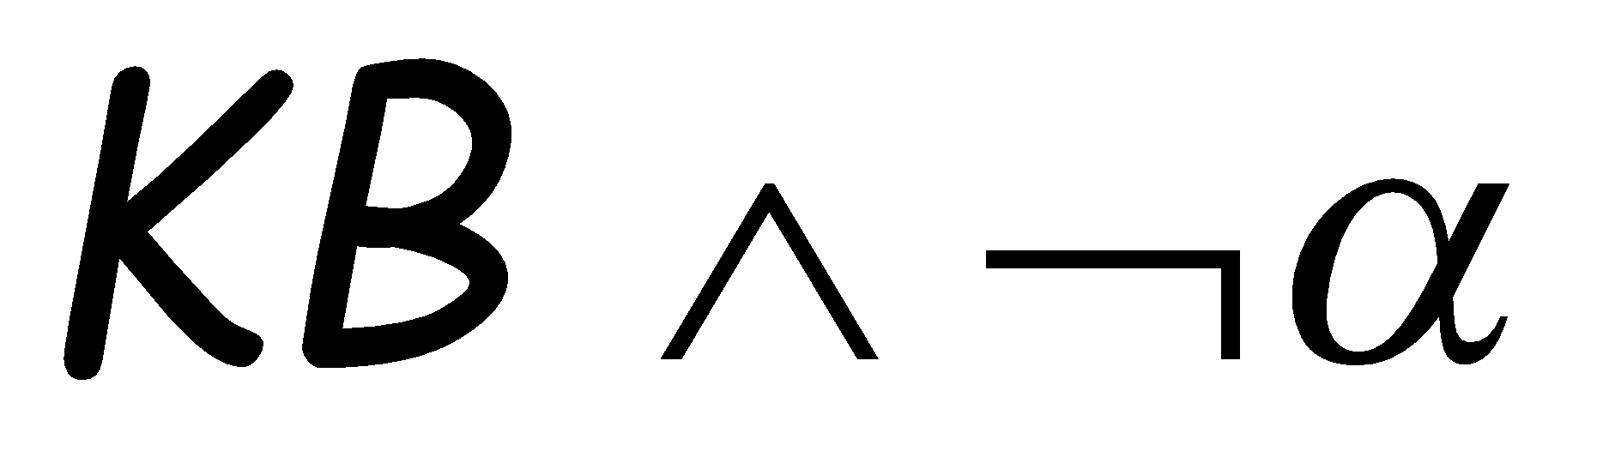
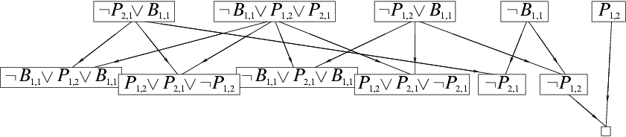
Resolution example
KB = (B_{1,1} ⇔ (P_{1,2}∨ P_{2,1})) ∧¬ B_{1,1}
α = ¬P_{1,2}
True!
False in
all worlds

Slide 43
Knoweldge Representation & Reasoning
Resolution: Inference procedure
Function PL-RESOLUTION(KB,α) returns true or false
Clauses ← the set of clauses in the CNF representation of (KB∧¬α) ;
New ←{};
Loop Do
For each (C_{i} C_{j} ) in clauses do
resolvents ← PL-RESOLVE (C_{i} C_{j} );
If resolvents contains the empty clause then return true;
New ← New ∪ resolvents
End for
If New ⊆ Clauses then return false
Clauses ← Clauses ∪ new
End Loop

Slide 44
Knoweldge Representation & Reasoning
Resolution: Inference procedure
Function PL-RESOLVE (C_{i} C_{j} ) applies the resolution rule to (C_{i} C_{j} ).
The process continues until one of two things happens:
There are no new clauses that can be added, in which case KB does not entail α, or
Two clauses resolve to yield the empty clause, in which case KB entails α.

Slide 45
Horn Clauses

Slide 46

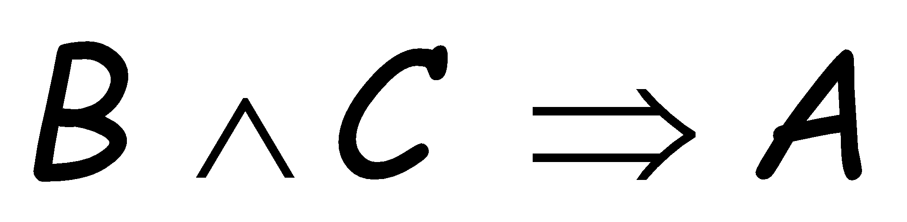
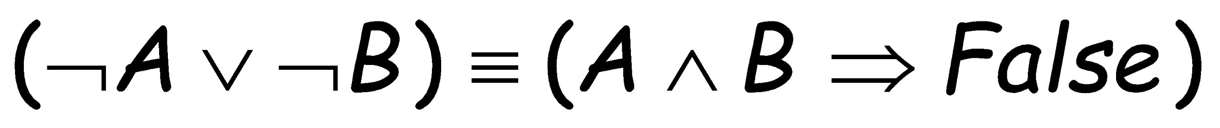
Horn Clauses
Resolution can be exponential in space and time.
If we can reduce all clauses to “Horn clauses” resolution is linear in space and time
A clause with at most 1 positive literal.
e.g.
Every Horn clause can be rewritten as an implication with a conjunction of positive literals in the premises and a single positive literal as a conclusion.
e.g.
1 positive literal: definite clause
0 positive literals: Fact or integrity constraint:
e.g.
Forward Chaining and Backward chaining are sound and complete
with Horn clauses and run linear in space and time.

Slide 47
Knoweldge Representation & Reasoning
Inference for Horn clauses
Horn Form (special form of CNF): disjunction of literals of which at most one is positive.
KB = conjunction of Horn clauses
Horn clause = propositional symbol; / or
(conjunction of symbols) ⇒ symbol
Modus Ponens is a natural way to make inference in Horn KBs

Slide 48
Knoweldge Representation & Reasoning
Inference for Horn clauses
α₁, … ,α_{n}, α₁ ∧ … ∧ α_{n} ⇒ β
β
Successive application of modus ponens leads to algorithms that are sound and complete, and run in linear time

Slide 49
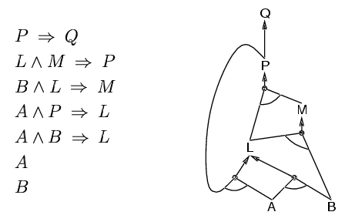
Forward chaining
Idea: fire any rule whose premises are satisfied in the KB,
add its conclusion to the KB, until query is found
AND gate
OR gate
Forward chaining is sound and complete for Horn KB

Slide 50
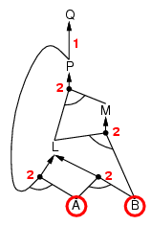
Forward chaining example
“OR” Gate
“AND” gate

Slide 51
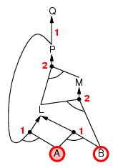
Forward chaining example

Slide 52
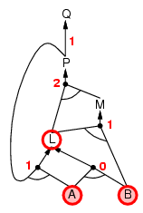
Forward chaining example

Slide 53
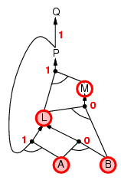
Forward chaining example

Slide 54
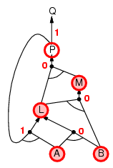
Forward chaining example

Slide 55
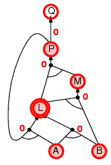
Forward chaining example

Slide 56
Knoweldge Representation & Reasoning
Inference for Horn clauses: backward chaining
• Idea: work backwards from the query q:
check if q is known already, or prove by backward chaining all premises of some rule concluding q.
Avoid loops:
check if new subgoal is already on the goal stack
Avoid repeated work: check if new subgoal has already been proved true, or has already failed

Slide 57
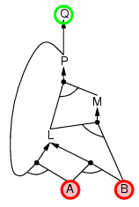
Backward chaining example

Slide 58
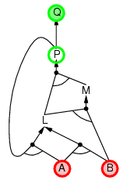
Backward chaining example

Slide 59
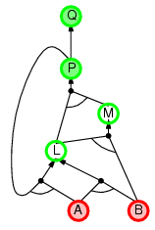
Backward chaining example

Slide 60
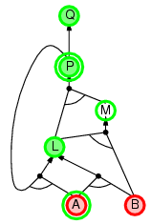
Backward chaining example
we need P to prove
L and L to prove P.

Slide 61
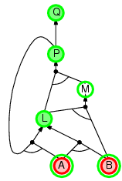
Backward chaining example

Slide 62
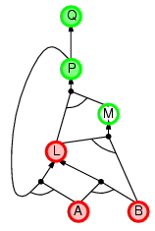
Backward chaining example

Slide 63
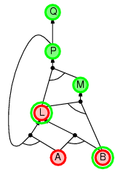
Backward chaining example

Slide 64
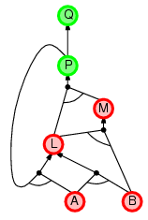
Backward chaining example

Slide 65
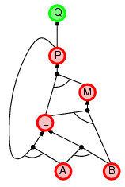
Backward chaining example

Slide 66
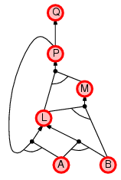
Backward chaining example

Slide 67
Forward vs. backward chaining
FC is data-driven, automatic, unconscious processing,
e.g., object recognition, routine decisions
May do lots of work that is irrelevant to the goal
BC is goal-driven, appropriate for problem-solving,
e.g., Where are my keys? How do I get into a PhD program?
Complexity of BC can be much less than linear in size of KB

Slide 68
Knoweldge Representation & Reasoning
Inference in Wumpus World
Initial KB
Some inferences:
Apply Modus Ponens to R₁
Add to KB
¬W_{1,1} ∧ ¬W_{2,1} ∧ ¬W_{1,2}
Apply to this AND-Elimination
Add to KB
¬W_{1,1}
¬W_{2,1}
¬W_{1,2}
Percept Sentences
¬S_{1,1} ¬B_{1,1}
S_{2,1} ¬ B_{2,1}
¬S_{1,2} B_{1,2}
…
Environment Knowledge
R₁: ¬S_{1,1}⇒ ¬W_{1,1}∧ ¬W_{2,1}∧ ¬W_{1,2}
R₂: S_{2,1}⇒ W_{1,1} ∨ W_{2,1} ∨ W_{2,2} ∨ W_{3,1}
R₃: ¬B_{1,1} ⇒ ¬P_{1,1}∧ ¬P_{2,1}∧ ¬P_{1,2}
R₅: B_{1,2} ⇒ P_{1,1}∨ P_{1,2} ∨ P_{2,2} ∨ P_{1,3}
...

Slide 69
Summary
Logical agents apply inference to a knowledge base to derive new information and make decisions.
Basic concepts of logic:
Syntax: formal structure of sentences.
Semantics: truth of sentences wrt models.
Entailment: necessary truth of one sentence given another.
Inference: deriving sentences from other sentences.
Soundness: derivations produce only entailed sentences.
Completeness: derivations can produce all entailed sentences.
Truth table method is sound and complete for propositional logic but Cumbersome in most cases.
Application of inference rules is another alternative to perform entailment.

Slide 70
References
Chapter 7 of “Artificial Intelligence: A modern approach” by Stuart Russell, Peter Norvig.

